Slide 1
Chapter 6
Socially Responsible Investment
Contemporary issues in Social Accounting

Slide 2
Chapter Structure
Introduction
Socially Responsible Investment Concept
SRI legitimacy in the 21st Century
Ethical and Moral Investment
Environmental, Social and Governance (ESG) Approach to SRI
SRI Strategies and Methods
Investment Fund Options
Summary

Slide 3
Introduction
One of the important aspects of business is how they attract and maintain financial investment to support and grow their organisation.
Businesses require investment; without it, there is no financing for operations that fosters growth. Some investors have their own set priority when committing cash to a corporation; this encompasses their social responsibility concerns.
These concerns have led to a practice known as Socially Responsible Investment (SRI).

Slide 4
Introduction
SRI can be viewed as investors responding to an organisation’s CSR action. It can act as a means to control corporate behaviour.
For example, investors may reward a particular behaviour by investing in an organisation, e.g. buying shares only in organisations that have dedicated commitment to Fair Trade sourcing.

Slide 5
Introduction
By choosing where to invest their wealth, investors have the power to grant or deny funding to organisations. In turn, organisations must follow expected standards or face lower investment, higher capital costs, or financial failure.
The concept of SRI has grown considerably in recent years particularly in response to the media raising awareness of the ruthlessness of corporate activity and social inequality across the globe.

Slide 6
Socially Responsible Investment Concept
Socially Responsible Investment (SRI) refers to an investment type that prioritises ethical and social concerns in addition to the traditional financial activities from selecting securities, portfolios and taking different production and investment decisions (Weigand et al., 1996).
SRI is also known as ethical investment, green investment, or sustainable investing, which seeks to achieve financial profitability where social, environmental, and ethical patterns are considered (Hutton et al., 1998; Lowry 1993).

Slide 7
Socially Responsible Investment Concept
The SRI concept is not new but has been around in various forms and guises for centuries.
History suggests that Islamic, Jewish and Christian religions embraced economic actions that aligned with their beliefs.
In the middle ages, the Catholic Church forbade loans to have interest or usury.

Slide 8
Socially Responsible Investment Concept
Some of the first records of social responsibility appearing within investment are argued to have been influence by religious tenets such as the old Jewish tradition (i.e. Talmud) and the Religious Society of Friends (Quakers).
There is also evidence of socially responsible investment within the Methodist faith dating back more than 200 years.
The Methodists favoured investments that aligned with their faith’s social principles such as the right to organise and bargain collectively, avoid discrimination (age, race, gender etc.) and be human.

Slide 9
Socially Responsible Investment Concept
In the 19th century for example, the church became very active in investing in public health and non-university education.
In the 1920s churches encouraged members not to invest in organisations that made money from gambling, tobacco, and alcohol.
A pioneer fund in 1928 was established to provide screening for investors who wished to avoid investing in organisations that did not match their personal values.

Slide 10
Socially Responsible Investment Concept
Many activist groups worldwide seeking greater social and environmental responsibility from organisations and governments such as:
Australia: the Australian Ethical Investment Association defines SRI as “the integration of personal values with investment decisions. It is an approach to investing that considers both the profit potential and the investment's impact on society and the environment.”
Canadian Social Investment Organisation: The Social Investment organisation defines SRI as “the process of selecting or managing investments according to social or environmental criteria.”
Sweden’s Forum for Sustainable Development: SRI “is investment that in addition to financial criteria, also takes social, ecological, and ethical factors into investment decision-making processes.”
UK Social Investment Forum: “Socially Responsible Investment (SRI) combines investors' financial objectives with their concerns about social, environmental and ethical (SEE) issues.”

Slide 11
Socially Responsible Investment Concept
European Social Investment Forum (Eurosif): “Socially Responsible Investment (SRI) combines investors' financial objectives with their concerns about social, environmental, ethical (SEE) and corporate governance issues. SRI is an evolving movement and even the terminology is still very much in the evolving phase. Some SRI investors refer only to the SEE risks while others refer to ESG issues (Environmental, Social, and Governance). Eurosif believes both are relevant to SRI. SRI is based on a growing awareness among investors, companies and governments about the impact that these risks may have on long-term issues ranging from sustainable development to long-term corporate performance.”

Slide 12
Socially Responsible Investment Concept
Association for Sustainable and Responsible Investment in Asia (ASrIA): “Sustainable and Responsible Investment (SRI), also known as Socially Responsible Investment, is investment which allows investors to take into account wider concerns, such as social justice, economic development, peace or a healthy environment, as well as conventional financial considerations.”
US Social Investment Forum: “Integrating personal values and societal concerns with investment decisions is called Socially Responsible Investing (SRI). SRI considers both the investor's financial needs and an investment’s impact on society. With SRI, you can put your money to work to build a better tomorrow while earning competitive returns today.”

Slide 13
Socially Responsible Investment Concept
By the 20th century, SRI had become very popular, such that a number of indices tracked market constituents deemed socially acceptable. Such as:
“Natur Aktien Index;
DJSI STOXX;
400 Social;
Impax ET500;
Such indices are useful to investors seeking to identify socially responsible organisations to invest in and to organisations themselves when seeking to attract new investors.

Slide 14
SRI legitimacy in the 21st Century
There has been a worldwide focus on enhancing the practice of SRI due to four factors (OECD,2007), these are:
The ability of public policy: This concern is associated with issues of environmental degradation and human rights abuses in developing countries, highlighting the importance of international business in ensuring responsibility and selecting capital structures to be in line with these issues.
Public opinion favouring SRI, as seen on social media and advocated by lobbying groups.

Slide 15
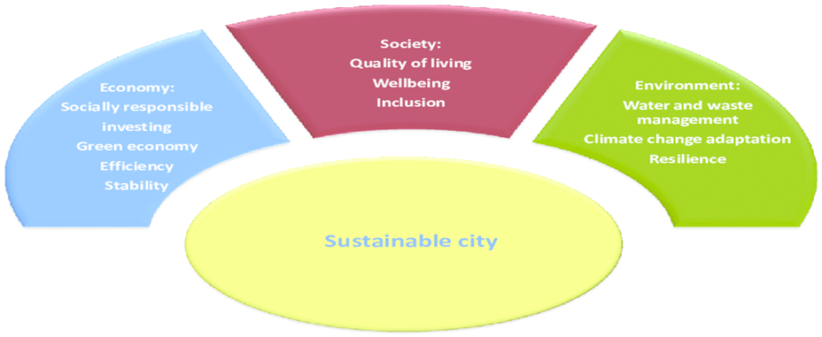
SRI legitimacy in the 21st Century
Fiduciary responsibility or financial returns. There are increasing perception in some countries that the former should come first.
Output of Empirical studies. There is supportive evidence that investors can increase their returns using Socially Responsible Investment (SRI).
Source, Szelagowske, A. and Marek Bryx.M (2015)

Slide 16
The UN role in SRI
For its part, the UN in 2006 developed a set of ten principles for the responsible investment.
These principles meet the minimum fundamental responsibilities for businesses in areas such as human rights, labour, and environment. The motivation behind developing such principles is concentrated in the lack of sufficient environmental and ethical considerations of global businesses practices and shareholders’ investment decisions.

Slide 17
The UN role in SRI
The UN’s Global Compact principles aimed at mobilising a global movement of sustainable, socially responsible businesses and stakeholders by supporting companies to operate responsibly by aligning their operations and activities with the ten principles and take strategic actions toward advancing sustainable development.

Slide 18
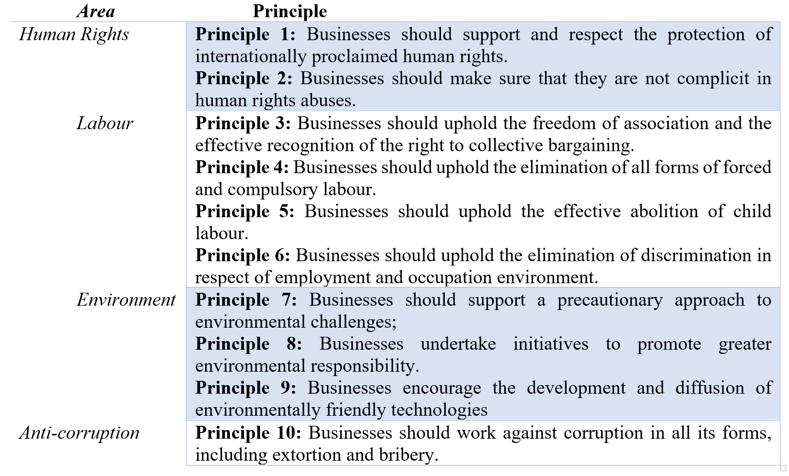
The Ten Principles of the UN Global Compact
Source: https://www.unglobalcompact.org/what-is-gc/mission/principles

Slide 19
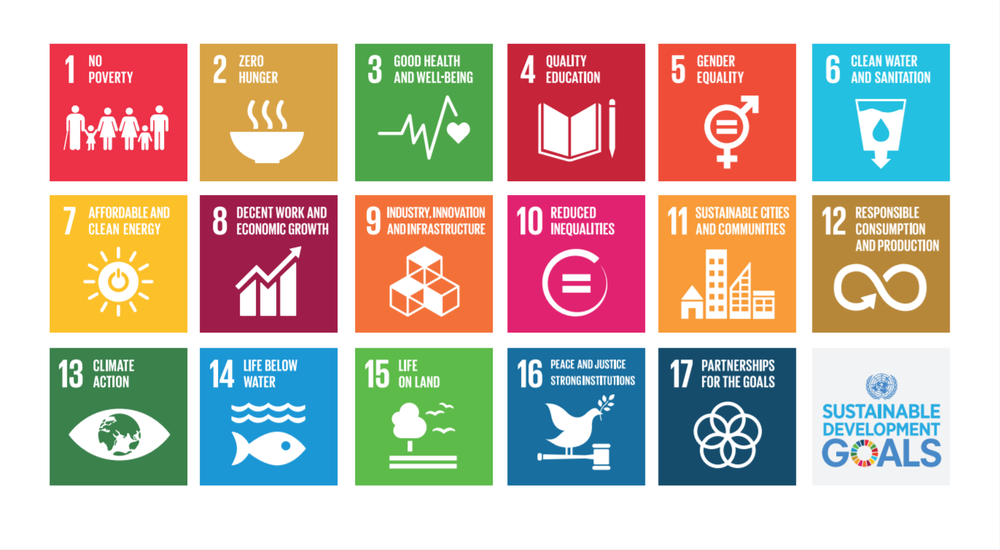
The UN role in SRI
To advance the global societal initiatives, the UN in September 2015 developed 17 Sustainable Development Goals (SDGs) of the 2030 Agenda for Sustainable Development.
Source: https://www.unglobalcompact.org/sdgs/17-global-goals

Slide 20
The 17 UN goals are
Source: https://sustainabledevelopment.un.org/?menu=1300

Slide 21
Ethical and Moral Investment
SRI is considered as a moral judgement and a financial judgement.
In the past, ethical investors were simply avoiding investing in organisations that act against their moral convictions or ethical beliefs.
More recently, investors tend to prioritise investments in organisations that comply with their moral values, such as organisations with high standards in governance and responsible environmental and social policies.

Slide 22
Ethical and Moral Investment
Fund managers now think about sustainability issues at every step of the investment process, the impact of issues such as climate change, safety, governance, and human rights.
Investors can achieve a good return by taking a long-term view and considering a very broad range of factors that might affect an organisation, including sustainability issues.

Slide 23
Environmental, Social and Governance (ESG) Approach to SRI
Fund managers now think about sustainability issues at every step of the investment process, the impact of issues such as climate change, safety, governance, and human rights.
Investors can achieve a good return by taking a long-term view and considering a very broad range of factors that might affect an organisation, including sustainability issues.

Slide 24
Environmental, Social and Governance (ESG) Approach to SRI
Environmental, Social and Governance (ESG) Approach:
Environmental Criteria
Social Criteria
Governance Criteria

Slide 25
Environmental, Social and Governance (ESG) Approach:
Environmental Criteria: focus on corporate energy use, waste, pollution, natural resource conservation and animal treatment.
Approach to Climate Change and Resource Depletion: The financial market is beginning to respond to scientific research that posits that the earth is experiencing climate change.

Slide 26
Environmental, Social and Governance (ESG) Approach:
Other areas considered by investors in regard to the environmental criteria for screening firms include but not limited to the following;
Hazardous Waste Disposal/ clean up
License to operate in communities
Renewable Energy
Nuclear Energy
Sustainability/ Resource depletion
Pollution
Toxic and Chemical use and disposal
Carbon emissions, greenhouse gas emissions, disclosure/measurement and reporting.

Slide 27
Environmental, Social and Governance (ESG) Approach:
The Societal Criteria evaluate the how the firm relates to the community. The community therein refers to employees, competitors, suppliers, and partners.
Areas:
Diversity i.e. fostering an all-inclusive working environment
Human Rights Protection
Consumer Protection
Welfare of Animals and Aquatics
Child Labour

Slide 28
Environmental, Social and Governance (ESG) Approach:
Governance criteria look at the structure of a firm’s board, its corporate practices, transparency of accounting methods, stakeholder structure amongst other areas.
Areas:
Managerial Structure i.e. Powers of the Board and CEO
Dual Class Share Structure
Employee Relations: Companies like Walmart were criticised for their labour practices.
Executive Compensation Scheme

Slide 29
SRI Strategies and Methods
There are various methods utilised in ensuring investment is not unacceptable to societal interest.
Predominantly, the strategy for SRI’s has been through screening, although this practice has changed over the years.
When faced with portfolio investment decisions, fund managers of ethical funds focus on screening firms based on socially responsible criteria.

Slide 30
SRI Strategies and Methods
Three approaches to use the of SRI are:
Responsible Engagement
Thematic investment and positive screening strategies
Avoidance or ‘negative screening’

Slide 31
SRI Strategies and Methods
Responsible Engagement
Within the responsibly engagement approach, organisations use dialogue, voting and responsible shareholder activism to encourage positive change and to help reduce the risk level associated with non-SRI.

Slide 32
SRI Strategies and Methods
Thematic investment and positive screening strategies
The thematic investment and positive screening approach focuses on directing investment towards corporations that meet a fund’s ‘positive’ SRI objectives.
Areas that could be considered include: organisations with good employee-employer relationship, that have strong environmental practices, that put human right protection in the forefront of their operation or are involved in products that are safe and useful.

Slide 33
SRI Strategies and Methods
Avoidance or ‘negative screening’
Negative screening (also known as avoidance or exclusion screening) symbolises the fund manager rejecting organisations that engage in activities that are deemed not socially acceptable or defined by a fund manager as ‘unethical’.
Activities termed socially unacceptable could include the provision of goods or services that can be used further political administrations repressive behaviour or to fuel political unrest (e.g. funding rebellion), that have a negative impact on the environment (e.g. oil and gas, mining), the production of tobacco, alcohol, abortion pills, weapons or other products that can be deemed harmful to health or human existence (Solomon and Solomon, 2004).

Slide 34
Screening Types
 | Positive Screening | Negative Screening
Definition | Refers to the fund manager determining what companies based on their features will be a good fit to an existing portfolio | Denotes the fund manager reject firms that partake in activities that are not socially acceptable.
Areas | •Corporations with good employee-employer relationship. •Firms with strong environmental practices. | Activities that have a negative impact on the environment (e.g. oil and gas, mining).

Slide 35
SRI Strategies and Methods
MCDM applications to SRI
The assumption of the portfolio theory is that investors are willing to take on a certain level of risk only if they are compensated by an equal or higher reward at a certain level of risk.
A substantial body of literature has argued for the inclusion of other criteria to better specify the preferences of investors (See Aouni et al., 2014).

Slide 36
SRI Strategies and Methods
MCDM applications to SRI
The emergence of non-financial performance indicators among the SRI literature underpins the necessity of broadening the definition of return to investors; a consideration of the stock returns at a permissive level of risk and societal returns indicates the presence of multi-facets of return.
The Multiple Criteria Decision Making (MCDM) policy helps ensure this criterion reflects on the portfolio of investors, as a bespoke portfolio can be built to suit investor’s moral values and stock return preference.

Slide 37
Investment Fund Options
Investors are expecting to demand sophisticated funds that fit well with their SRI goals.
For example, investors encouraged by the growth of green and ethical investment embraced by insurance products such as Takaful, pension funds, and ISAs, which balance between social or environmental issues and are achieving a decent return have become particularly attractive.

Slide 38
Investment Fund Options
The factors considered by SRI investors can be categorised in three groups as follow:
Social Factors
Ethical Factors
Environmental Factors

Slide 39
Investment Fund Options
Mutual Funds
A mutual fund refers to a skilfully managed investment fund that pools money from a wide array of investors and purchases securities. This has been an important vehicle for SRI investors, in recent years; there has been a surge in the number of SRI mutual funds.
The main benefit of mutual funds is the professional management of portfolio as well as the diversification of the portfolio, the major drawback of mutual funds are the fees required to maintain them.

Slide 40
Investment Fund Options
Mutual Funds
Mutual funds can be classified in terms of structure (Closed-end funds, Open-end funds, Unit Investment Trusts, and Exchange-traded funds) as well as in terms of the type of underlying investment (Money market funds, Bond funds, Stock funds and Hybrid funds).

Slide 41
Mutual Funds
Close-end Funds are normally created through a typical IPO (Initial Public Offer) and the shares are traded on a stock exchange afterwards.
Open-end Funds buy back shares when offered for sale at the close of business on a daily basis.
Exchange Traded Funds (ETF) shares both attributes of the open-end funds and the close-end fund. They are traded on the stock exchange.

Slide 42
Other major SRI fund forms:
Responsible Engagement Funds - this style aims to perform more responsible business practices to enhance investor returns with better risk management
Sustainability Themed Funds - focus on the sustainability agenda when deciding on sources of investments.
Balanced Ethical Funds - are ethically screened funds that balance the positive and negative aspects of company behaviour across a range of ethical, social and environmental issues.
Environmentally Themed Funds - integrate environmental opportunities and risks into their investment decisions.

Slide 43
Other major SRI fund forms:
Negative Ethical Funds - avoid a range of activities that do not meet more traditional, ethical or ‘values based’ standards.
Faith Based Funds - are limited group of funds that invest in line with a specific set of religious values.
Clean Technology Funds - operate in markets leading clean technology and environmental solutions companies.
Specialist Funds - include investments which fall within the broad definition of SRI but do not fit within any of the above forms of funds.

Slide 44
Summary
We have acknowledged that SRI is not a new concept but has evolved over many centuries and has been influenced by a number of factors including religion, culture and the preference of regions.
Socially Responsible Investment (SRI) has witnessed a remarkably broad expansion and has become a norm among the investors and in academia.
Responsible Investment (SRI) operates to encourage better social and environmental performance by organisations and to improve actual financial performance in a sustainable economy.

